Slide 1

Cross Lanes, Wrexham
May 21st-23rd 2025

Slide 2
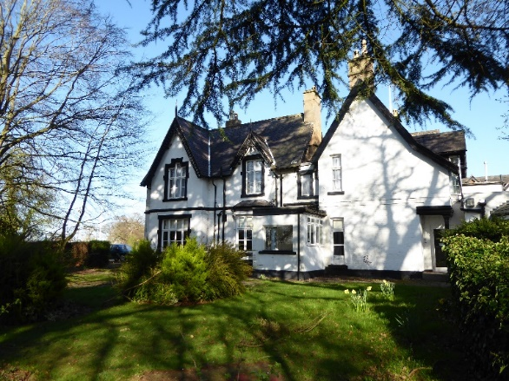
Robinwood Centre Cross Lanes
-The centre used to be a hotel.
-The dormitories, dining rooms, shower block and toilets are inside the hotel building.
-There are also some activities inside such as escape room activities.
-Outside there is a small lake for rafting and canoeing.
-There is an outside high ropes activity, night line (obstacle course), giant swing and zip wire.
-There are two additional buildings: one for climbing activities (crates, trapeze and climbing wall) and one for archery and caving.

Slide 3

Hollins Grundy Staff
Mrs Jacques
Mr McKenzie
Mr Richardson

Slide 4
Other staff
-One senior member of staff.
-Two group leaders for 2 activity groups.
-Cooks.
-Staff to supervise dining room.
-Extra staff to help put on harnesses and complete safety checks.
-Night staff to supervise at night.

Slide 5

The centre is just for KS2 so there will be no older high school children on site.

Slide 6
Supervision
At night, there are boys and girls dormitories.
We will ensure all children are in a dormitory with some friends they have chosen.
Dormitories have security on doors. If a child opens the door at night there is a sensor which is activated and night staff who patrol the corridor are alerted.
Checks are completed from Robinwood staff throughout the night.
Children have an alarm they can press if they want the night staff to come.
Children aren’t allowed in each others dormitories during the day or at night.
School staff are also on hand at night if needed. School staff bedrooms are near each set of rooms.
Reports are given to school staff every morning. If children have not behaved they may have to miss an activity.
Children will have their reliever inhalers over night in case there are needed in the night.

Slide 7
Dormitory Groups
To be decided when we have our rooms allocated.

Slide 8
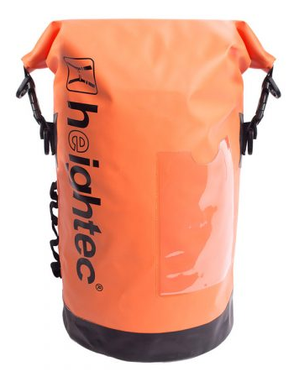
Toilets, showers, kit.
En-suite toilet in each room with a sink and toilet to use at night.
There are toilets in the main building to use in the day.
Showers happen during the day after wet activities.
There is a shower block with 12 individual cubicles with doors and a bench to put their bag on.
Wet clothes are collected and washed by Robinwood staff so make sure everything is named.
Children pack their kit bag every morning with what they need for the day, change of clothes and shower things.
Bags are stored in a group kit cupboard so children do not need to go back to their room in the day.
School group leaders will carry reliever inhalers for their group.
Mrs Jacques will administer any other medicines and look after brown and purple inhalers.

Slide 10
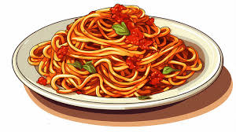
food
-Children choose their food on arrival.
-In addition to meals snacks and drinks are provided throughout the day.
-If your child has dietary needs they will provide options for them which are similar to the normal menu but fit your child’s needs.

Slide 11
Activities
-Robinwood ensure your child is busy from every moment spent at Robinwood, from wake-up around 7.00am to lights out (and sleep!) at about 9.00pm.
-Staff wake them 30 mins before breakfast to dress and pack kit bags.
-Activities in groups start after breakfast.
-Both groups meet up for breakfast, lunch and dinner.
-After activities finish all groups meet for team games and reflection.
-Bed-time is around 8.30 pm. They have time to get ready and relax in their room.
-Lights out are about 9.15pm.

Slide 12

Day1
Wednesday
Arrivals are typically about 11.00am
Rooms & Lunch make your bed
Caving
Knights’ Quest
Evening meal
Piranha pool
Climbing
Hot chocolate and review and team games.

Slide 13
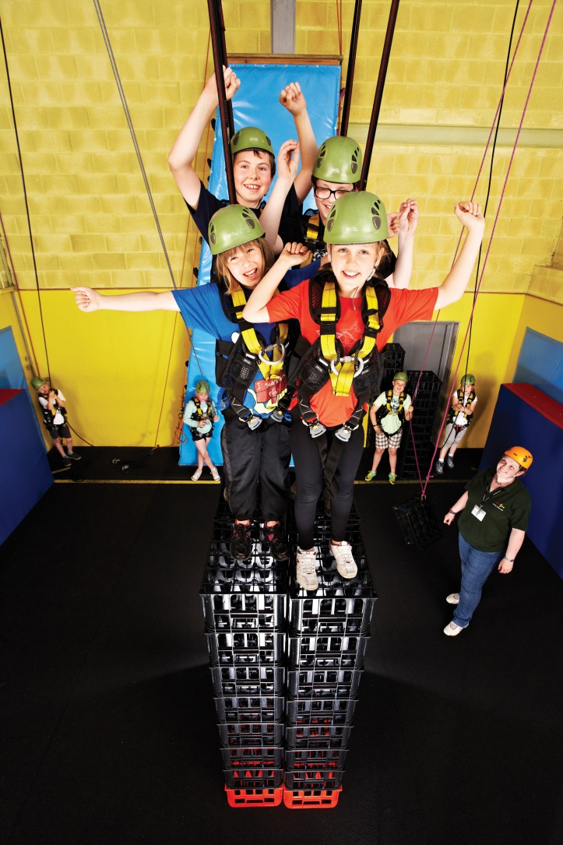
Day2
Thursday
Breakfast
High Ropes
Crate challenge
Kayaks
Lunch
Dungeon of Doom
Raft Building
Night line
Evening meal
Team challenge
Hot chocolate and review

Slide 14
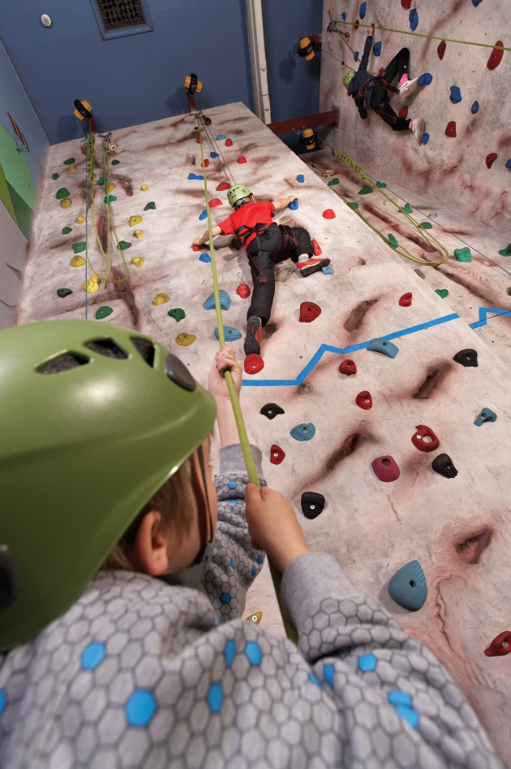
Day3
Friday
Breakfast
Trapeze
Archery
Lunch
Departures are typically about 2.00pm

Slide 15
Points to remember
1. You don’t need a sleeping bag.
2. Travelling clothes and shoes need to be practical.
3. Children need clothes and shoes suitable for physical activities outside. There is a list available to help. Clothes will get dirty and wet so don’t bring your best clothes and trainers.
4. Some activities like caving and archery are better with joggers or leggings and a hoodie or jumper so don’t just pack shorts and short sleeved T-shirts.
5. Robinwood provide waterproof trousers, tops and shoes in case of rain and for some wet activities.
5. Clothes should be named and children need to be aware what belongs to them so get them to help you pack.
6. No mobile phones or other electronic devices or gaming equipment allowed including watches which text or access the internet.
7. No sweets or gum allowed. Robinwood staff will take sweets if they find them.
8. No spray deodorant, body sprays or aerosols.

Slide 16

Medication & Illness
If you have told us about a medical condition on your information form that requires medication please also fill in a school medical form today to give us permission to administer medication and leave it with us.
If your child requires medication at the time we go to Robinwood, which is new and not on their info form, please fill in a school medical form with dosage and name of medication.
We can only administer medicine which is prescribed by a doctor and has the doctor’s label on with your child’s name and dosage.
If your child regularly needs a non-prescription medicine eg calpol for headaches or stomach aches, hayfever meds please can you ask you doctor to prescribe it and fill in a form.

Slide 17
Medication & Illness
If your child needs travel sickness tablets please can you get a prescription for them or we can’t give them to your child for the return journey.
If your child has asthma and has inhalers in school we can’t be sure how much is left in them and if it will be enough for the trip. So please send a new inhaler or one you know has plenty in it with doctors information on the box so we know it is prescribed.
Robinwood have the same policies as school for sickness and diarrhoea, i.e. children can’t mix for 48hrs following an episode. If your child has a stomach bug the day before the trip we can’t take them.
If your child has a stomach bug whilst they are at Robinwood we will have to ask you to collect them as Robinwood staff will insist on this. If it happens in the night we will call you the next morning unless we really need to call you.

Slide 18
Behaviour & Expectations
-Behaviour expectations are the same as they would be at school (if not higher, as we’re off site and representing our school).
-Be polite and helpful
-Listen to instructions and do as you are told
-Wear your helmet when asked don’t mess with harnesses.
-Try your best
-Robinwood Code of Conduct …
Read this with your child. Staff will expect them to follow this. If children misbehave they may have to miss an activity.

Slide 19
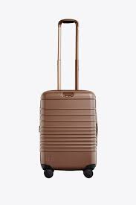
Day of the trip
-Make sure your child’s bag has a luggage label attached we will give these out on the Monday of the trip
-Before school from 8.30, drop your bag at the Hollins Community Centre as the coach will go from here. Mr McKenzie will be there make sure you tell him you have dropped the bag so he can check it off on his list.
-If your child is being dropped at Owls take their luggage to Owls and we will take it down to the coach.
-Bring any medicines to the school office and give them to Mrs Jacques (forms should be handed in before this but if you haven’t filled in a form make sure you ask for one before your drop the medicine off.)
-This includes inhalers as we will take them on the coach.
-Children should come into school and register as usual.
-We will leave about 9.30am from the Community Centre.
-School office will text when we get there.
-If you need to contact us contact the school office.

Slide 20
EnD of trip
-We aim to be back for the end of school (3.30) on the Friday. If we are late due to traffic we will let you know by text.
-Collect your child and their luggage from the Community Centre. Wait for an member of staff to hand your child over so we can check everyone is collected and pass on any messages if needed.
-If someone different from usual is collecting your child let us know.
-Let us know if your child is going to Owls and we will take them to Owls with their luggage.

Slide 21
Paperwork
If your child needs medication fill in the form tonight and hand in.
2. If your child needs medication nearer the time fill in a medication form and return to Mrs Jacques asap.
3. Children’s Code Of Conduct- go through with your child.
4. Read the kit list emailed to you.
5. Souvenir Form. Please return along with the money by Tuesday 20th May.
6. Fill in luggage labels and attach to cases. I will give these out nearer the time.
7. Last payment is due 9th May.

