Slide 1
Welcome to Year 4!

Slide 2
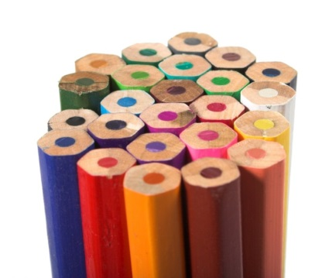
Staffing
Mr McCrudden(Class Teacher)
Mrs Hughes (HLTA, PPA cover)
Mrs Gresty (1 day a week)

Slide 3
Uniform
Grey or black skirt or trousers
White polo top or school logo top
Red cardigan or jumper
Uniform with logo can be purchased from the school website.
No jewellery, wrist bands etc
https://www.hollinsgrundy.com/parents-carers/uniform-and-jewellery/
Please label all your child’s clothes.

Slide 4
Other
No mobiles, fitbits, smart watches
Open day 9th November (books)
Parents evening – online
School information on the website –texts are reminders
Parking
Additional support

Slide 5
PE
Monday and Tuesday (this half term)
Please send your child to school in their PE kit on PE days!
Shorts or tracksuit pants (black, navy or grey tracksuit pants can be worn)
T-shirt - in house colour
School jumpers and cardigans can be worn over the top of PE kits.
Pumps and trainers (recommended for outside)
Plasters

Slide 6
Reading
Guided Reading in class to teach reading skills
Weekly read with Mr McCrudden and Mrs Hughes during guided reading or appropriate times.
Reading books to be read independently, children will change their own books when needed.
Children's reading levels checked when necessary with Mr McCrudden and Mrs Hughes
Children need to read widely
Read to your children
Books swap

Slide 7
Spelling
The children will have new spellings each week.
A list has been sent home with the children.
Spellings are available on the class website.
Weekly spelling test will be every Wednesday
Records kept by Mr McCrudden, children are to inform parents of scores
Children need to be learning their 100 words, these will be made available on Teams and our class page.

Slide 8
Time table test
Knowing x tables to 12x12 is essential! There is a statutory test in year 4. This will be in the summer term.
Children will learn their times tables weekly
Children will have a weekly times table test
https://www.timestables.co.uk/multiplication-tables-check/

Slide 9
Maths
Maths is not hard!
We work through each element of maths and will have a focus on children applying the skills.

Slide 10
English
Currently we are working on story writing. All writing sessions build up to an extensive piece of writing.
Some genres we look at;
Play scripts
Free verse poems
Recounts
Explanation texts
Weekly poets

Slide 11
Topic
Science-
What happens to the food we eat.
Topic-
Geography- 1. River study and city locations. 2. Use of maps, atlases and globes.
History- 1. The Roman Empire and its impact on Britain. 2. British history including crime and punishment, leisure and entertainment in the 20th century. 3. Normans culture.
Art, Design and technology- split into 6 subjects.

Slide 12

Educational visits
Enhance learning done in school
Give children valuable experiences
Links learning to ‘real life’
We hope to be going on some trips this year.

Slide 13
Behaviour
‘Always’ Chart (name moved down if not following the school rules)
3 ‘Always’ lost in a week - letter from Head Teacher goes home!
Standards (age)

Slide 14

Homework
Weekly homework will be on new software. This will allow children to practise their spellings and maths skills.
After the success of the last homework grid we will continue to do this in school. Children will be provided with the new grid on Friday which has 6 different tasks for the children to complete.
These go on display
Importance of homework.

Slide 15
Brass Lessons
Every child in Year 4 will learn to play a brass instrument
No cost to parents (letter to be signed regarding care of instrument)
Music teacher will teach every Friday afternoon (not me- I will be learning with the children!)
Some children may wish to do extra sessions, this would be at a cost to parents.

Slide 16
General information
We are a nut free school
Parking at school
Our school website is updated on a weekly basis to inform parents of any upcoming events.
Red triangle
Safeguarding – secure school site
Attendance, we have a before and after school club service available ‘Owls’

Slide 17
How to help your child
Encourage their independence
Encourage them to learn times table facts
Encourage them to read, read, read (but still read to them too!)

Slide 18
Internet Safety
We teach internet safety in school under guidance of Child Exploitation &Online Protection Unit
Please safeguard your children at home

Slide 19
Thank you.

